Slide 1

2019
DATATHON
TEAM 22 REPORT
Chutong Xiao Wanxing Dai
Yutong Liu Qinyang Fang

Slide 2
1
Introduction
CONTENTS
2
API
Prediction Model
3
Possible Improvements
4

Slide 3
01
Introduction

Slide 4




Historical
Data
NLP
Twitter
NY Times
ARIMA Model
Time
Series
Sentiment
R
Stock

Slide 5
02
NLP on APIs

Slide 6
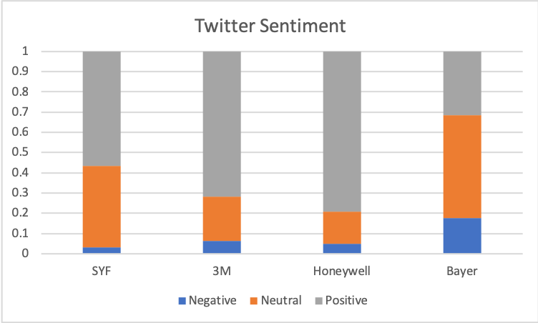
Twitter API

Slide 7
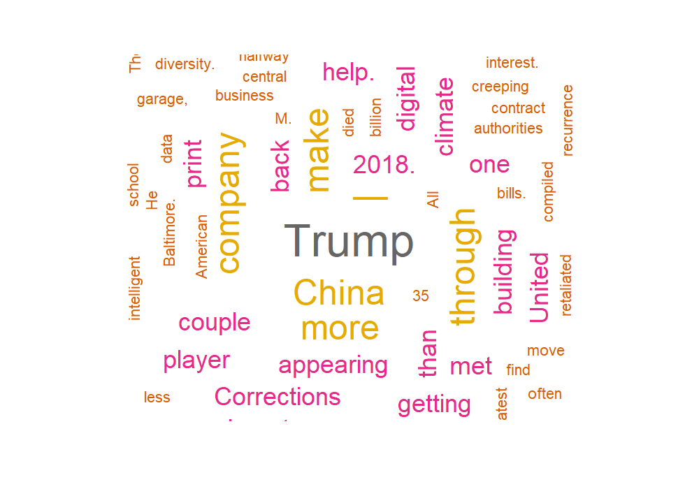

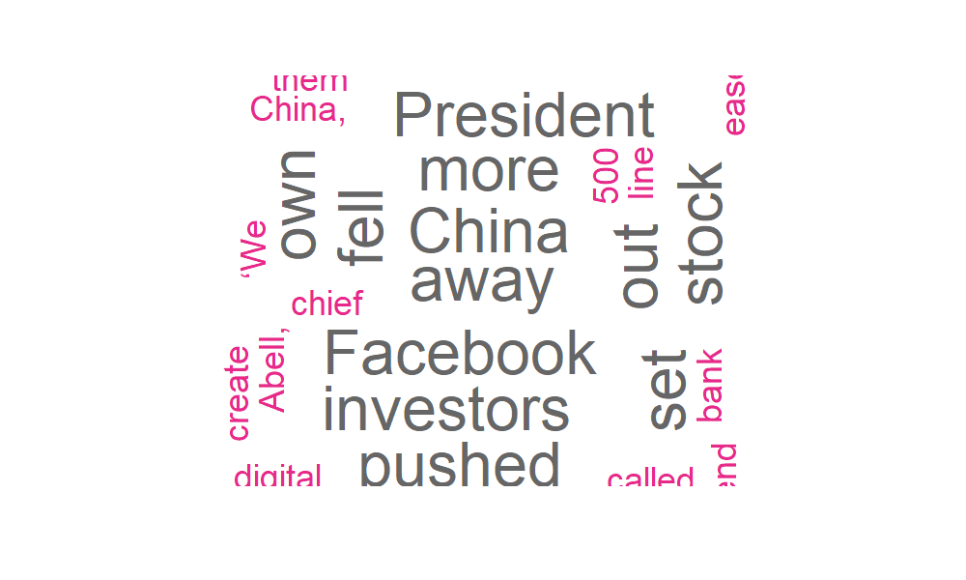
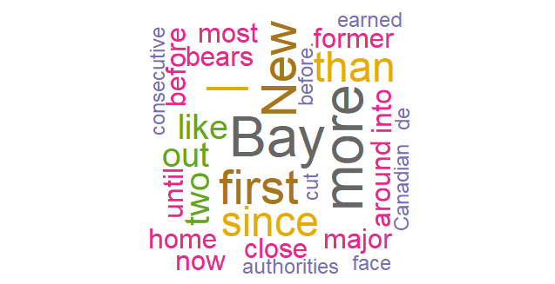


New York Times API

Slide 8
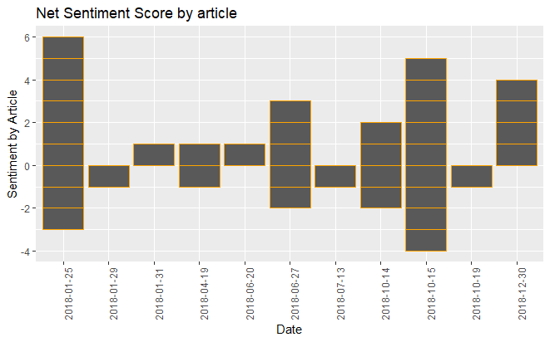
Positive = 1
Negative = -1

Slide 9
03
Prediction Model

Slide 10
Log Returns Plot
Time Series
ARIMA MODEL
Estimate
& ForeCast
Autoregressive Integrated
Moving Average
Notes:
text source: https://en.wikipedia.org/wiki/Autoregressive_integrated_moving_average
Both of these models are fitted to time series data either to better understand the data or to predict future points in the series (forecasting). ARIMA models are applied in some cases where data show evidence of non-stationarity, where an initial differencing step (corresponding to the "integrated" part of the model) can be applied one or more times to eliminate the non-stationarity.

Slide 11
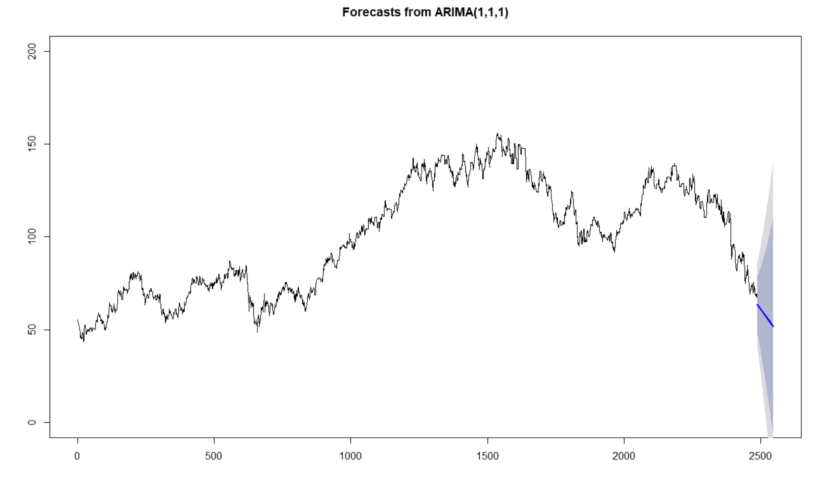

Slide 12
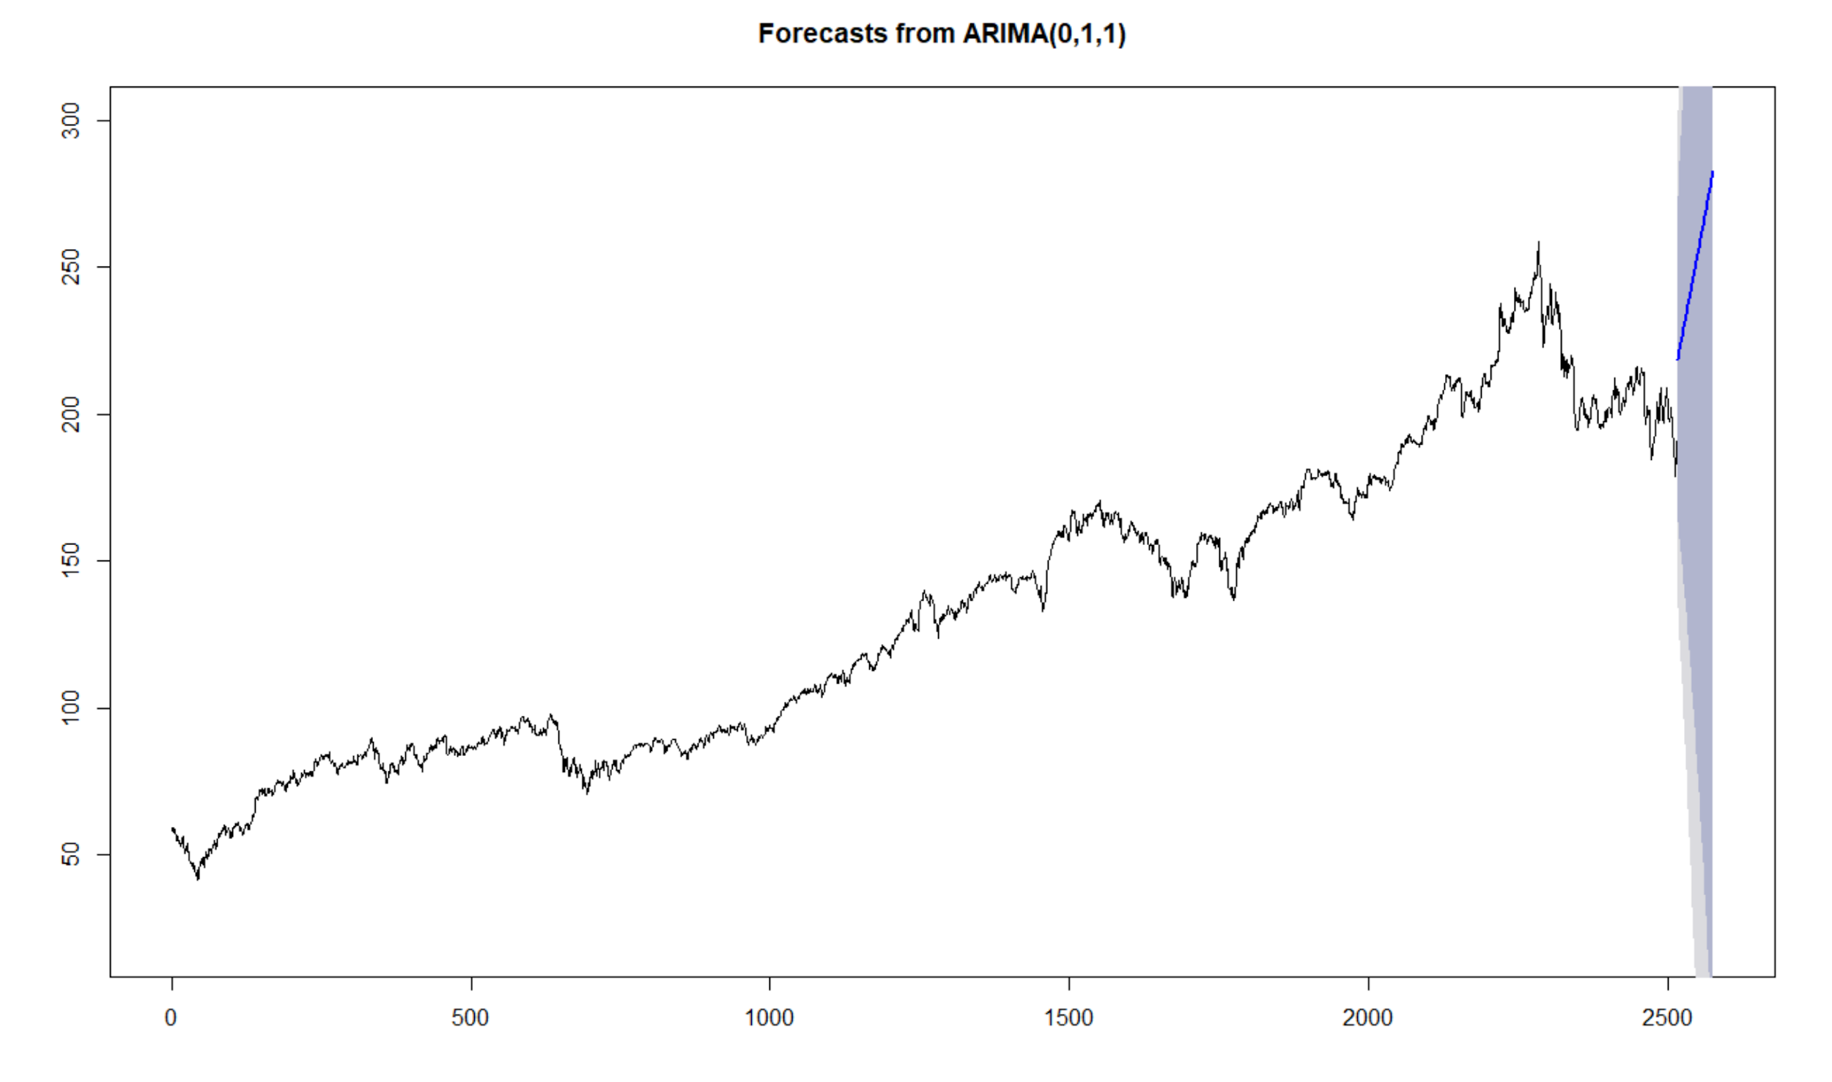

Slide 13
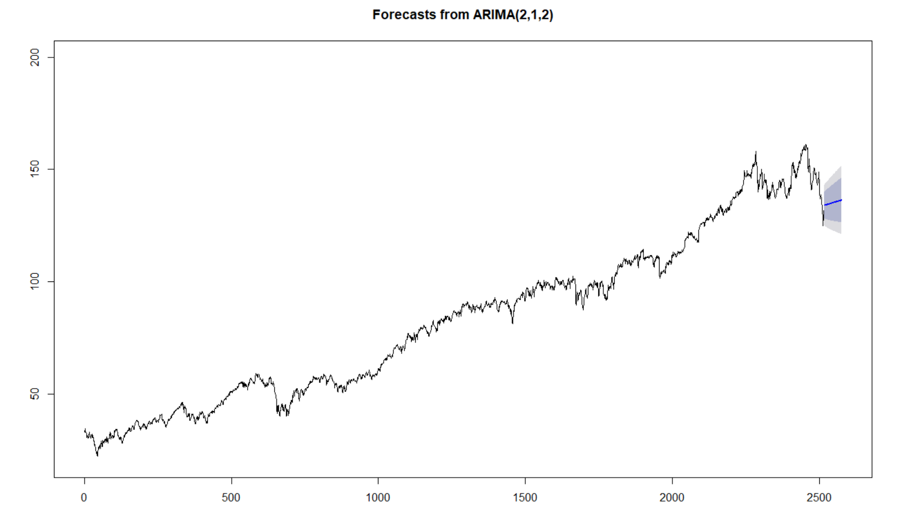

Slide 14
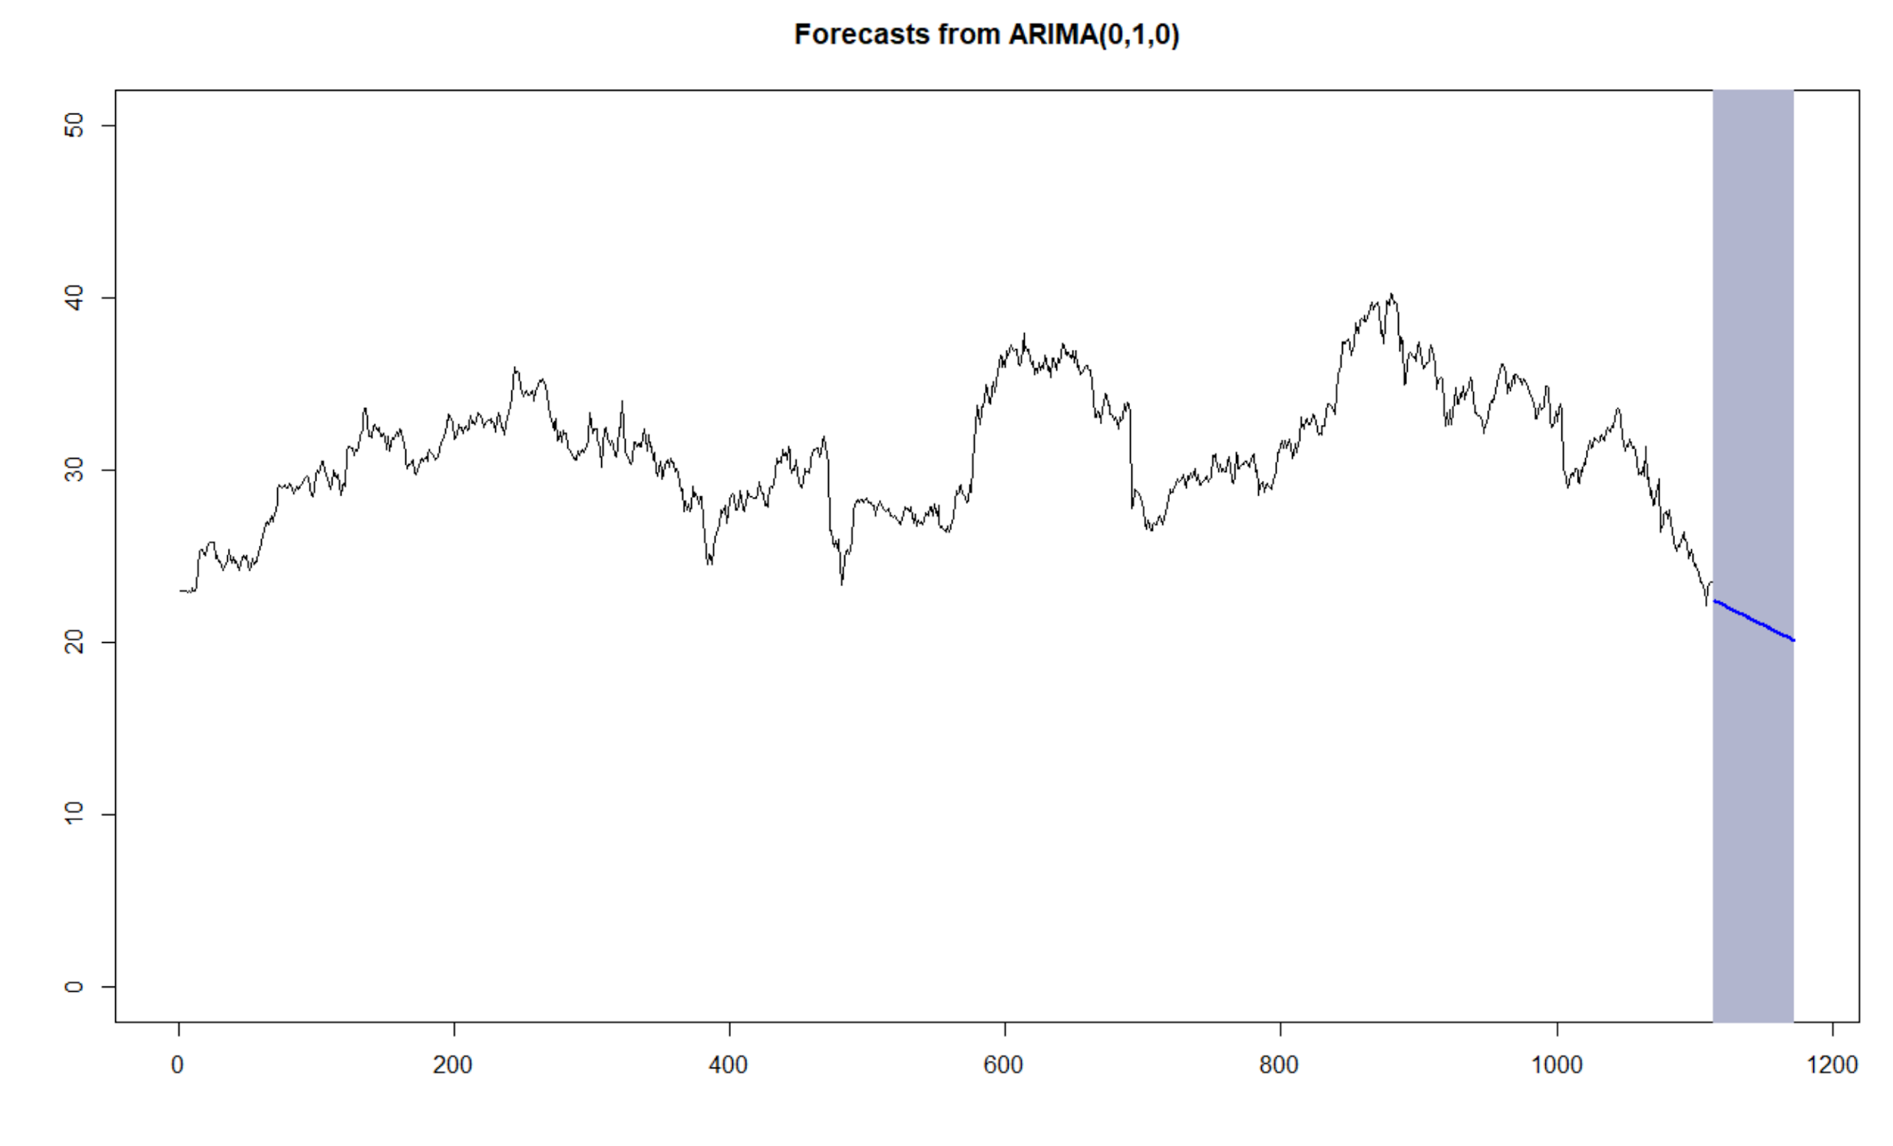

Slide 15
Winner:

Slide 16
Possible Improvements
04

Slide 17
For the sentiment of NYTimes articles, we could have generated more data but due to time limits we only selected data in 2018.
Twitter only allows access to data at most 7 days prior to the present date, which leads to insufficient tweets collected
We tried to change the legend color of historical data to red and blue, but we encountered some technical difficulties.
We only used one model to make prediction. Our analysis could be more precise with the combination of EARCH model.
Time
Limits
Model
Color

Slide 18
Thank you!
References:
https://rpubs.com/leenam/FitchDSC1
http://dataaspirant.com/2018/03/22/twitter-sentiment-analysis-using-r/
https://www.cnblogs.com/bicoffee/p/3838049.html

